Slide 1


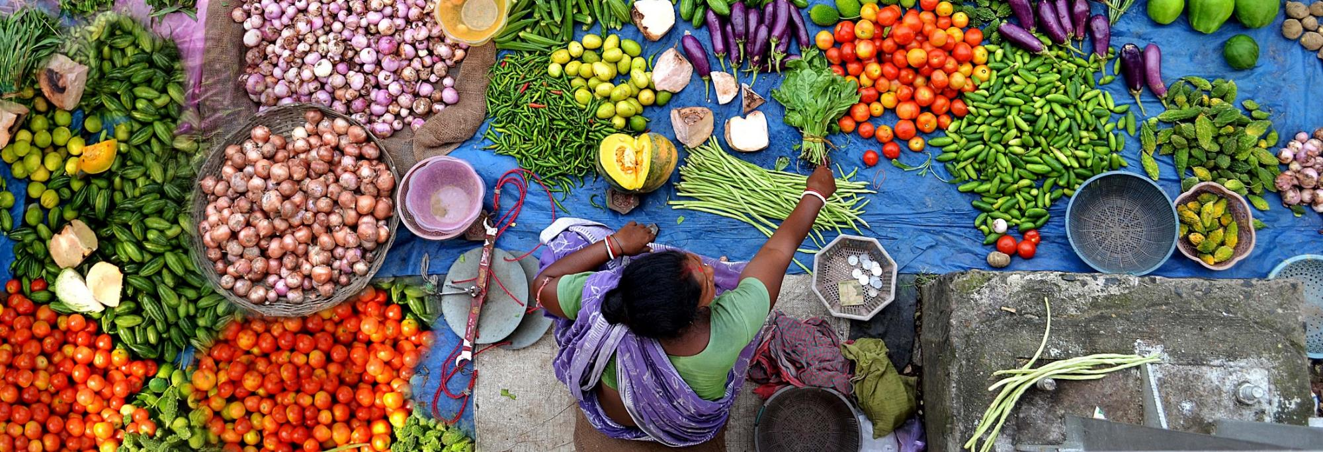
The “tricot” crowdsourcing methodology for varietal diversification
Bioversity International, Information Services and Seed Supplies

Slide 2
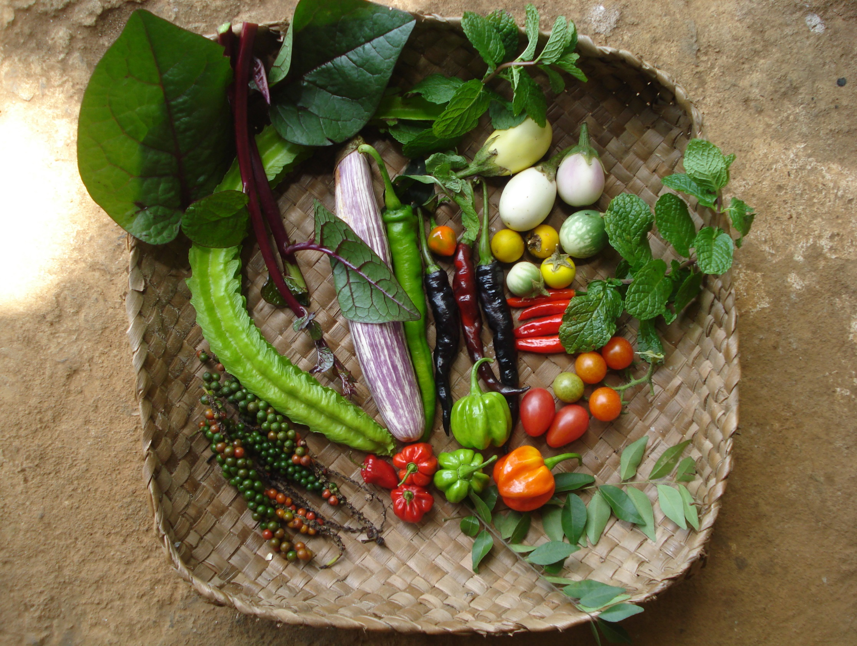
Agricultural biodiversity nourishes people and sustains the planet
Photo credit: LI-BIRD/A.Subedi

Slide 3
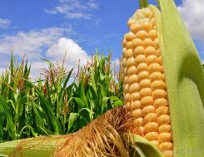
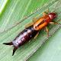

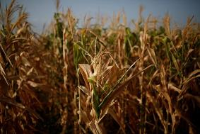
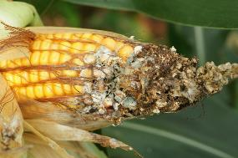
Challenge: Climate change
Holmgren et al. (2013) Nat. Clim. Change 3:755-758
Challinor et al. (2016) Nat. Clim. Change 6:954-958
Deutsch et al. (2018) Science 361(6405):916-919
Notes:
IPCC predicts that climate change will reduce agricultural production by 2% every decade while demand will increase by 14% every decade until 2050
Yields of major crops will face an average decline of 8% for Africa and South Asia by 2050.
Major staple grains have already experienced significant climate change-related yield reductions of 40 million tonnes per year from 1981 to 2002.
Up to 40% of the world’s land surface will develop novel climates, often with new pest and weed complexes.
Source:
Intergovernmental Panel on Climate Change (2014) IPCC WGII AR5 Summary for Policymakers in: Climate Change 2014 – Impacts, Adaptation, and Vulnerability. Intergovernmental Panel on Climate Change 44 p.
Lobell D.B.; Field, C.B. (2007) Global scale climate-crop yield relationships and the impacts of recent warming. Environmental Research Letters 2: p.1-7.

Slide 4
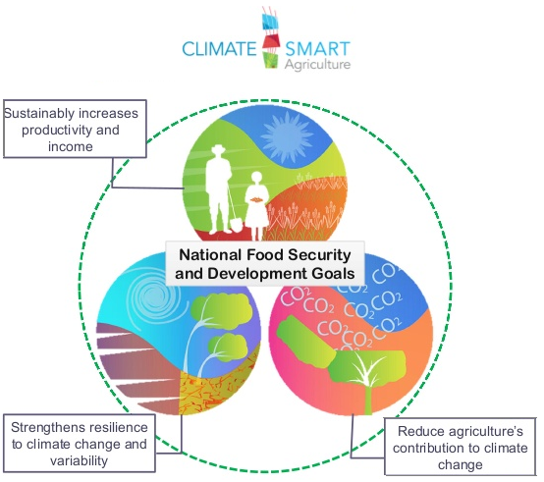
Challenge: Climate change
We need diverse, location-specific and scalable solutions for a climate adapted agriculture
Diversification and varietal selection are among the proposed solutions
But how farmers see these changes and challenges…
Lipper et al. (2014) Nat. Clim. Change 4:1068–1072

Slide 5
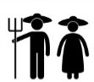
But, current methods lacks scalability

Slide 6
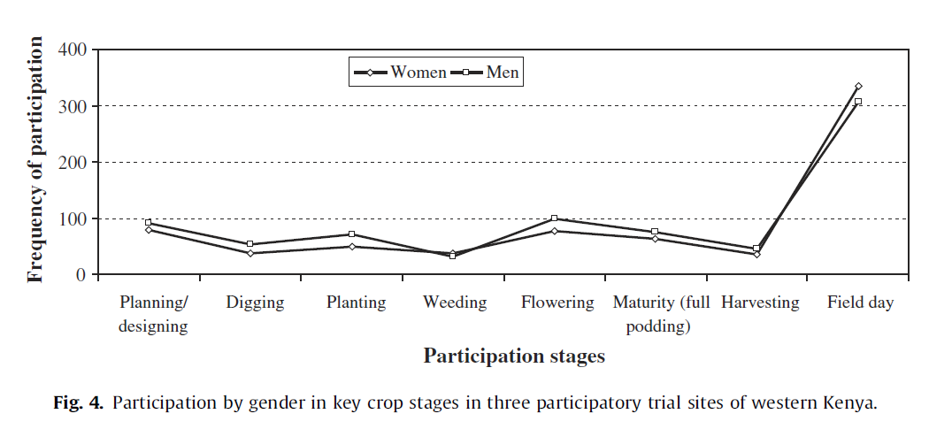
But, current methods lacks scalability
Misiko (2013) Agricultural Systems 119:35-42

Slide 7
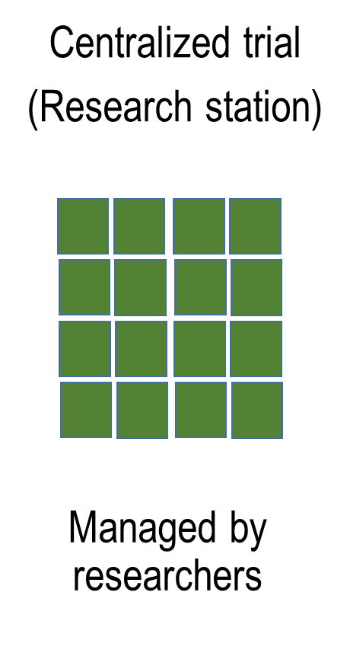
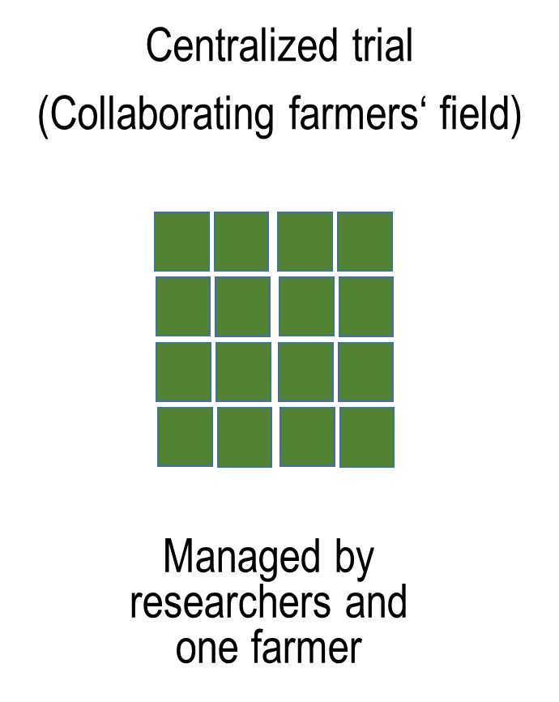
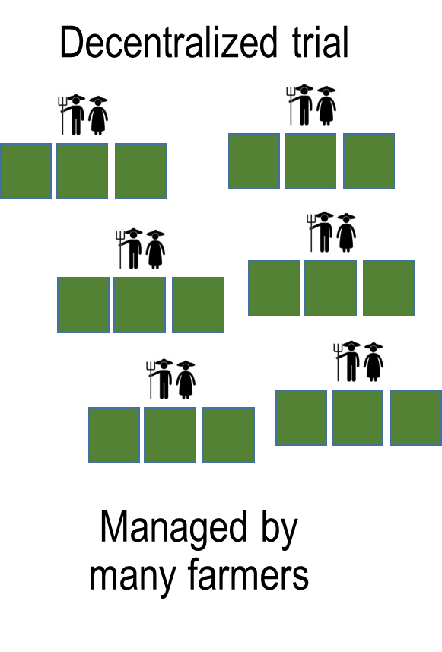
A new agricultural research paradigm

Slide 8
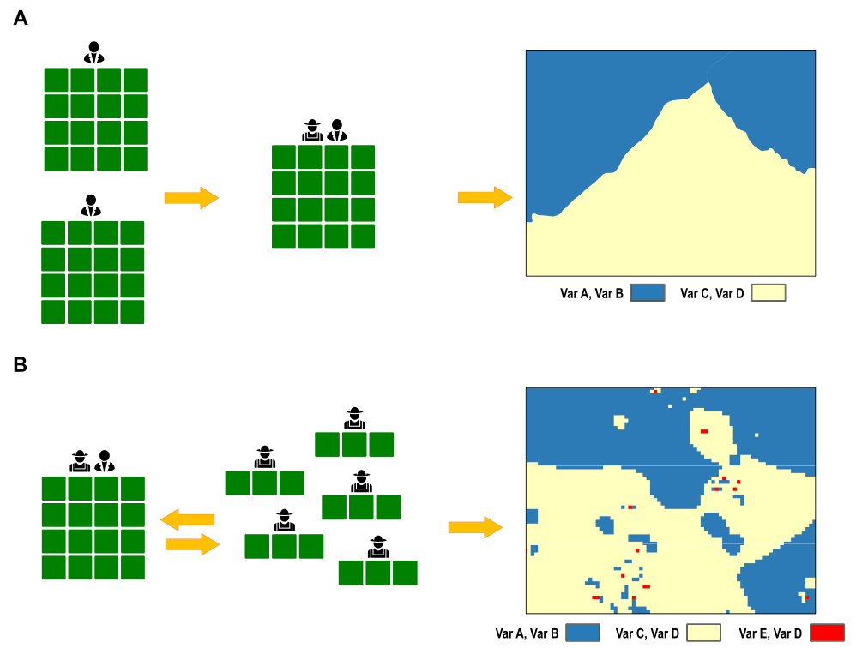
A new agricultural research paradigm

Slide 9
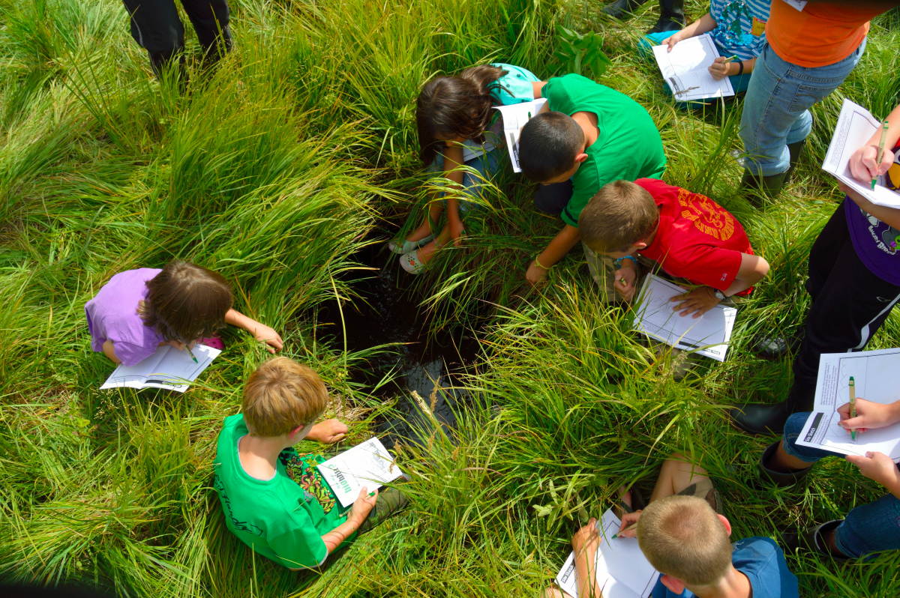
Citizen science Scientific research carried out, at least in part, by non-professional scientists

Slide 10

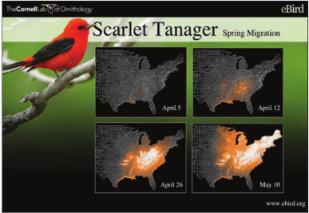

Citizen science
Dickinson et al. (2012) Front. Ecol. Environ. 10(6):291-297

Slide 11
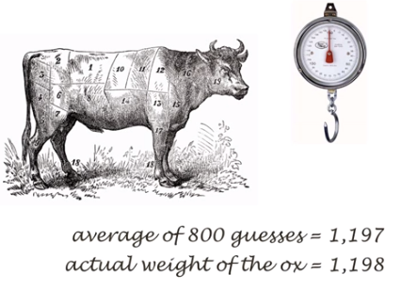
“Wisdom of Crowds”
In 1906, the English polymath Francis Galton visited a country fair in which 800 people took part in a contest to guess the weight of ox.
Surowiecki (2004) The wisdom of crowds.

Slide 12
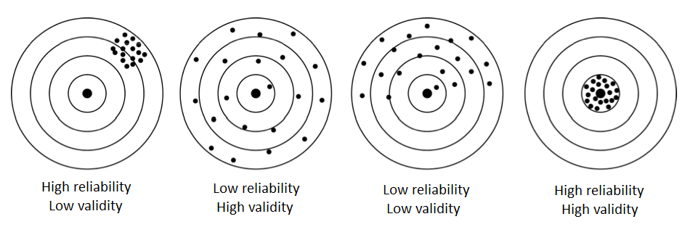
Data accuracy: Reliability vs validity
?
Notes:
Low reliability: You don‘t always hit the center.
But high reliability: By looking at the cloud of shots, we can still figure out where the center is.

Slide 13
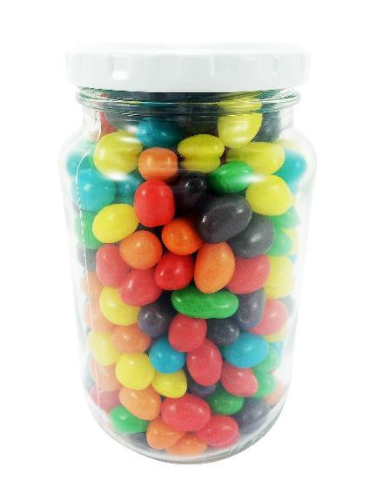
Exercise – wisdom of crowds
Notes:
Lets take a look how it works in this simple exercise

Slide 14
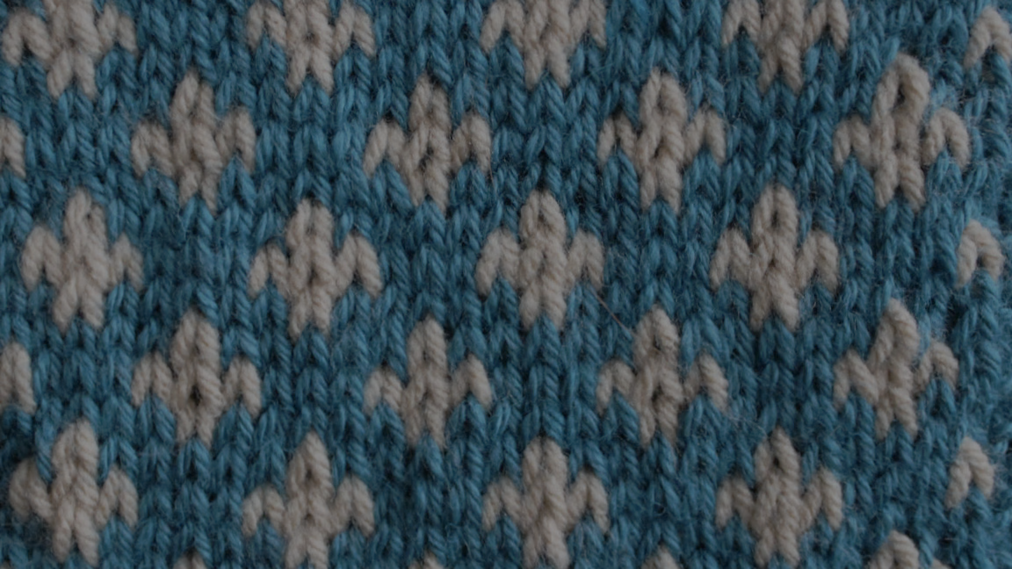
triadic comparisons of technologies tricot

Slide 15

Distributed variety trials instead of centralized experiments
Each farmer observes just 3 varieties
Farmers observe along the entire season
Under real farm conditions
Farmers rank the varieties, no need for exact measurements
van Etten et al. (2016) Expl. Agric.
Beza et al. (2017) PloS ONE 12(5):e0175700

Slide 16


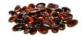
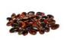
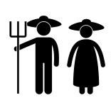
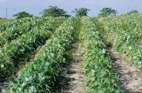
Each farmer receives 3 varieties from a larger pool of pre-selected varieties
A
B
Package #1
C

Slide 17
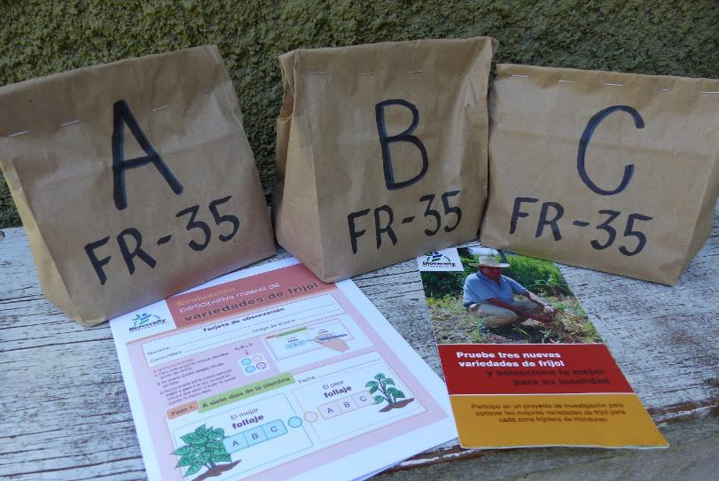
Each farmer receives a personal trial package
Small quantities of seed
3 different varieties
According to a randomization scheme
Observation card to record variety comparisons

Slide 18
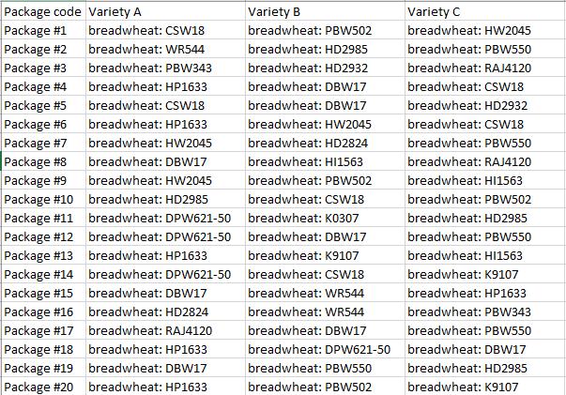
Variety randomization in tricot
Every farmer receives 3 out of 10 - 25 varieties
Farmer does not know the varieties names at first (just “A”,”B”,”C”)
Systematic randomization

Slide 19
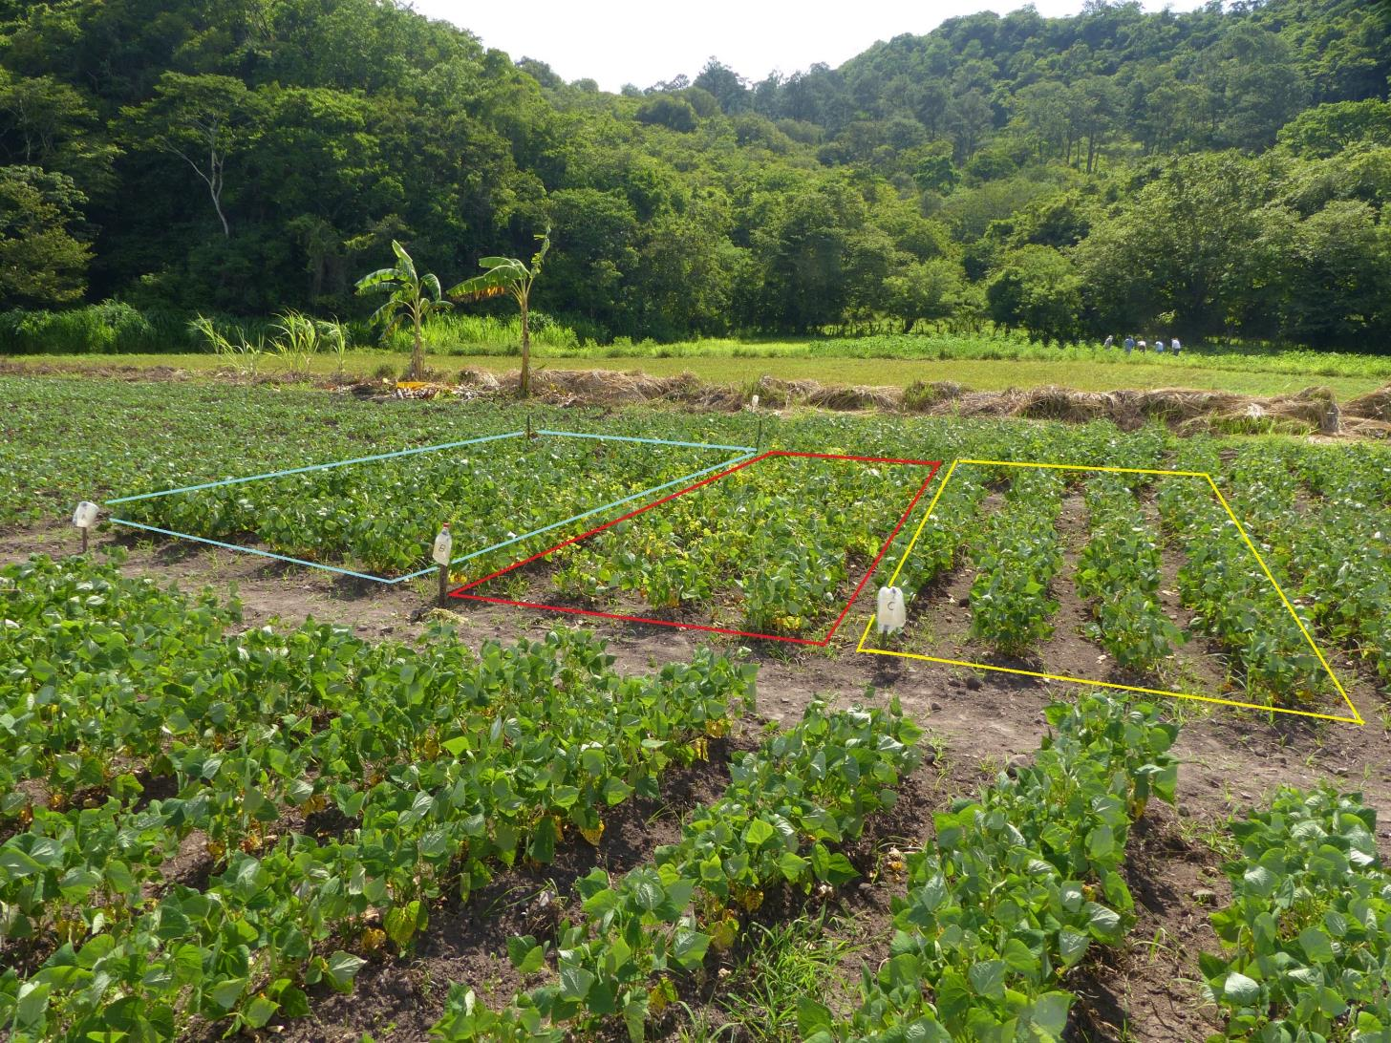
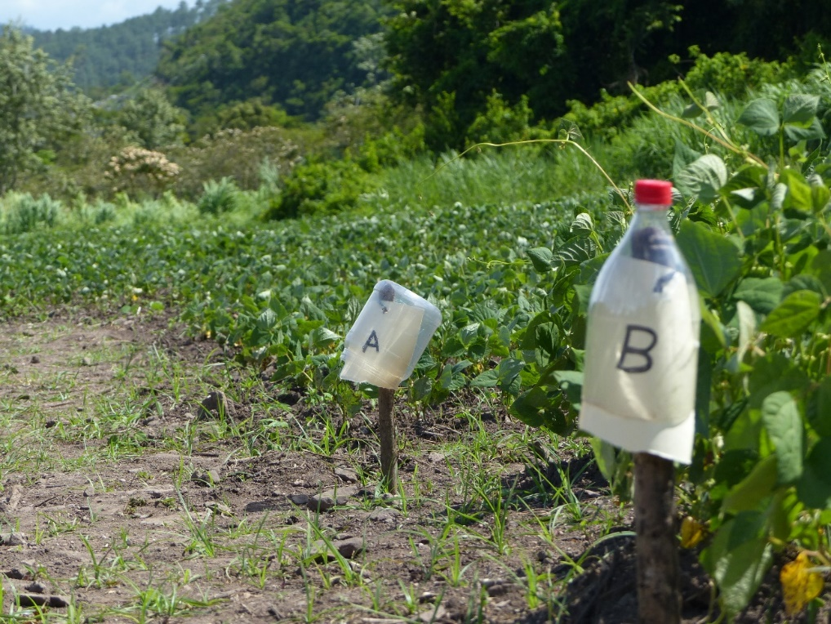
A tricot trial of common bean (Honduras)
A
B
C
Bean production plot (local variety)

Slide 20
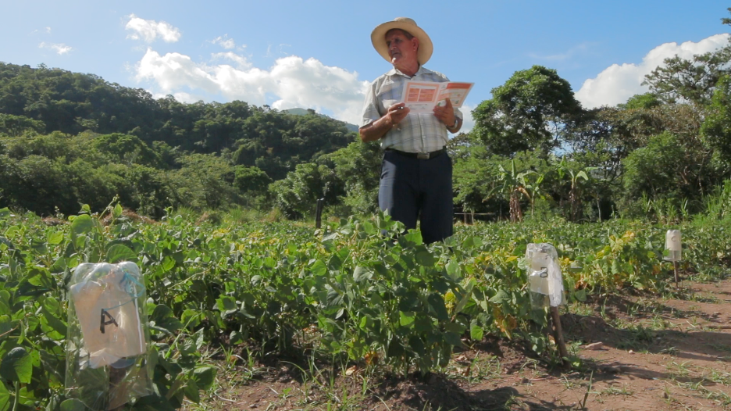
Farmers make simple observations in different criteria

Slide 21
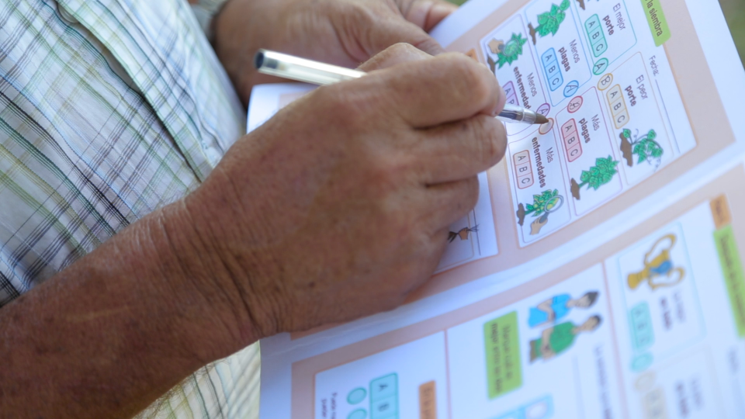
Farmers make simple observations in different criteria

Slide 22
Farmers make simple observations in different criteria
Package number: ____________
Step #1
After 30 Days
Date: ____________
Best leaf development
Worst leaf development
Best in winding
Worst in winding
Notes:
Specific, observable criteria
That are relevant to the farmers
We always ask for the best and the worst
Two questions only: Very simple for the farmers
When you have more than three varieties, it gets more complicated

Slide 23
Farmers make simple observations in different criteria
FR-35
Package number: ____________
Step #1
After 30 Days
10 November 2018
Date: ____________
Best leaf development
Worst leaf development
C
A
Best in winding
Worst in winding
B
C
Notes:
Specific, observable criteria
That are relevant to the farmers
We always ask for the best and the worst
Two questions only: Very simple for the farmers
When you have more than three varieties, it gets more complicated

Slide 24
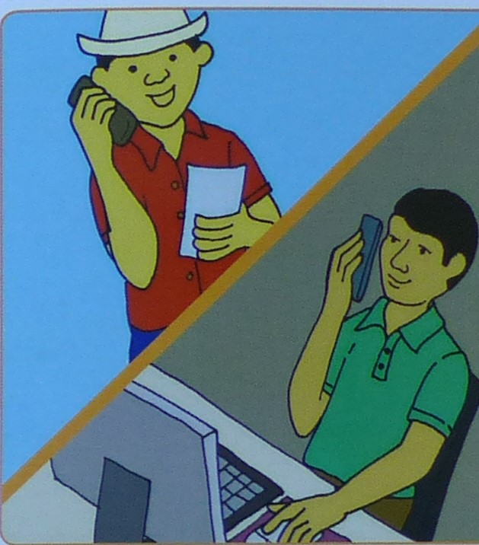
Project managers collect data from farmers, for analysis
Phone calls
ODK app
Type card information

Slide 25

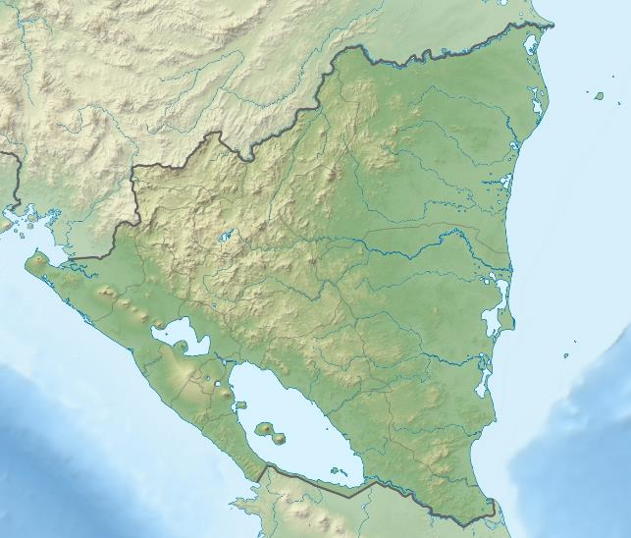

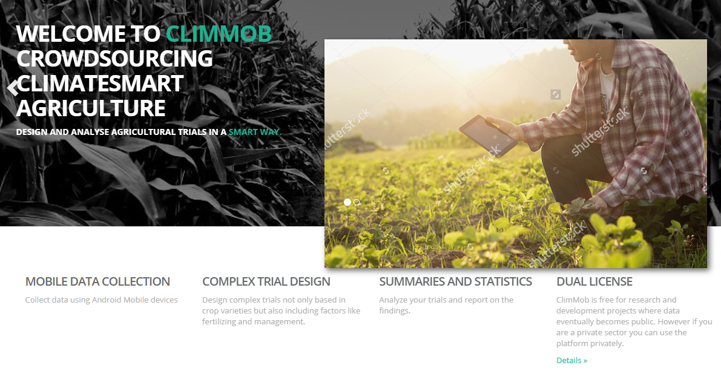

Slide 26
Combining many partial rankings to the full picture
+ -
A > C > D
C > D > G
A > D > G
A>C>D>G
Turner et al. (2019) CRAN PlackettLuce

Slide 27
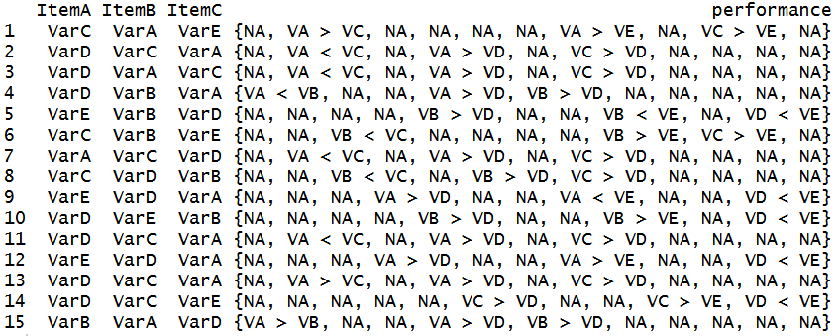
Model with partial rankings

Slide 28
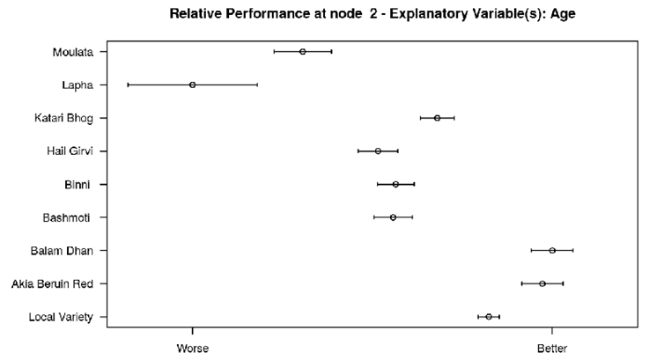
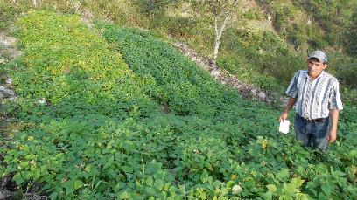
Two levels of learning
Local learning – Farmers use comparative approach and heuristic learning to identify suitable solutions
Global learning – Researchers aggregate results and infer patterns, make decisions about which varieties work where
Notes:
Tricot is a research methodology, but also a tool for diversity dissemination
In some cases, it is not even used for research, juts to introduce diversity to farms

Slide 29
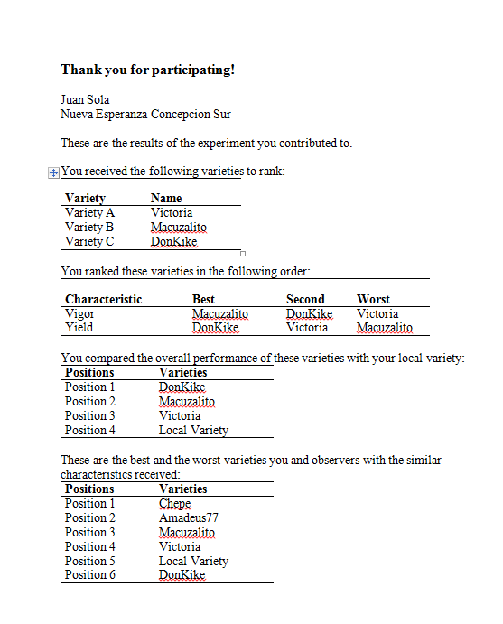
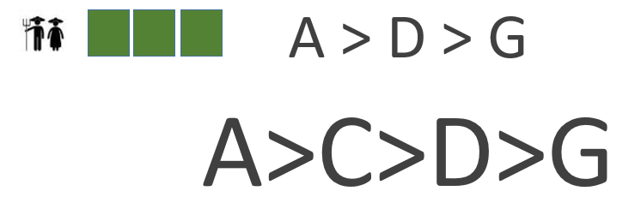
Local learning
Farmers learn names of the 3 varieties
Full variety ranking according to all farmers

Slide 30
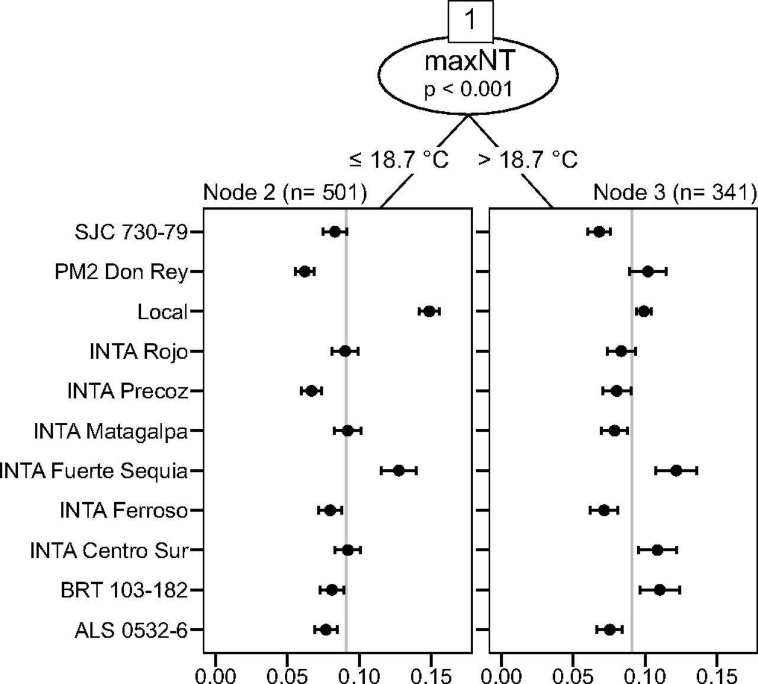
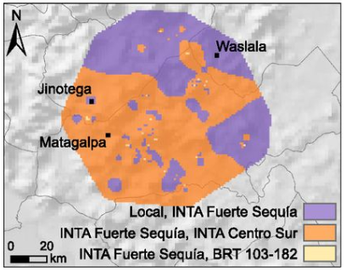
Global learning
van Etten et al. (2019) PNAS 116(10):4194-4199

Slide 31




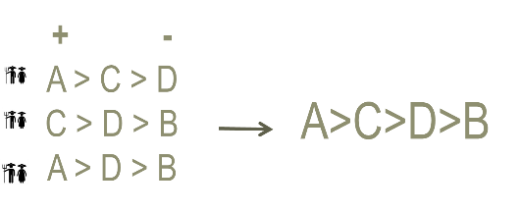

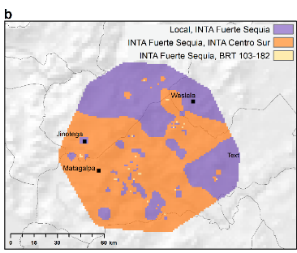

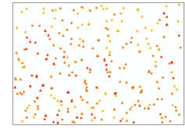

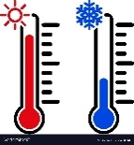



Slide 32
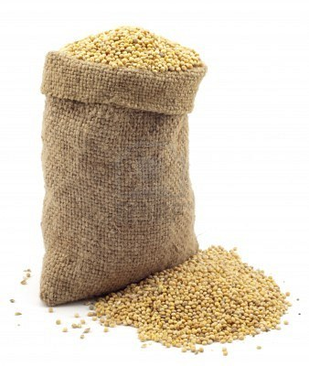
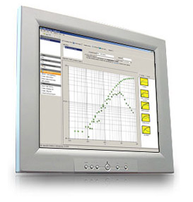
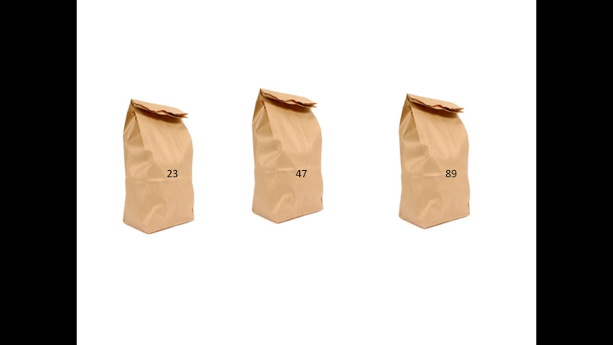


The cycle of tricot research
1. A broad set of varieties (10-25) is evaluated
5. Data are used to evaluate varieties and to detect demand for new varieties and traits
A > C > D
C > D > G
A > D > G
A>C>D>G
6. Farmers receive variety recommendations and can order seeds
2. Each farmer gets a combination of 3 varieties
3. Farmer plants a trial and makes observations
4. Project managers collect farmers’ observations
van Etten et al. (2016) Expl. Agric.
Beza et al. (2017) PloS ONE 12(5):e0175700
Notes:
The ultimate aim is that the whole seed system becomes more responsive. Information goes around to keep constantly adapting to change, matching seeds to emerging needs.

Slide 33
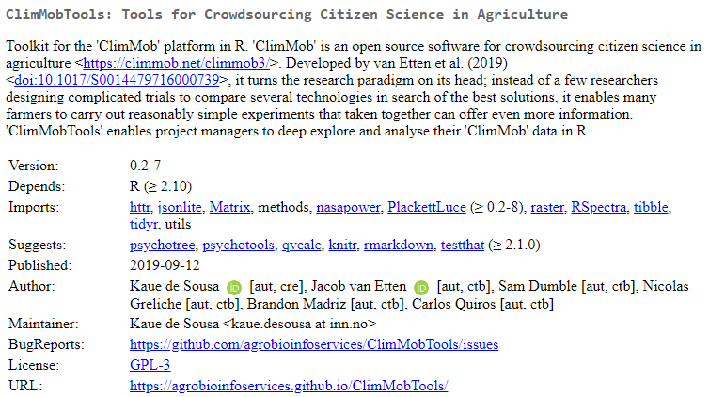
ClimMobTools: Tools for crowdsourcing citizen science in agriculture
de Sousa et al. (2019) CRAN. ClimMobTools
https://agrobioinfoservices.github.io/ClimMobTools/

Slide 34
In summary
Simple setup – little farmer training needed
Research / project staff does not need to supervise or visit trials
Results collected remotely through telephone calls
Trials under real farming circumstances
Observation along the entire cropping cycle
Accurate results thanks to “Wisdom of Crowds”
Farmers may quickly identify varieties that fit the conditions at their farm

Slide 35

Thank you!

Slide 36
This is a compilation of several presentations of the members of Bioversity International’s “Information Services and Seed Supplies” Team. If you need to cite it, we suggest the following:
Steinke, J.; Gupta, A.; van Etten, J.; de Sousa, K. (2019) The “tricot” crowdsourcing methodology for varietal diversification.
Other materials used in this training course are available at:
https://github.com/agrobioinfoservices/training
For the editable .ppt files, please send a request to
k.desousa@cgiar.org

